Slide 1

Real-time signal adaptation for
multi-directional heavy traffic
Guided By: Dr. Uma Gurav ma’am
Team Members:
Yash Nashte (B48)
Arushi Agrawal (B01)
Reva Tamboli (B19) Mugdha Chavan (B72)

Slide 2

The Challenge of Urban Traffic
1
Growing Congestion
2
Static Timing
Urban areas face increasing traffic congestion due to population growth and vehicle ownership.
Traditional traffic lights often use fixed timing schedules, which are ineffective in dynamic traffic scenarios.
3
Need for Smart Solutions
There's a pressing need for intelligent, scalable, and adaptable traffic management systems.

Slide 3
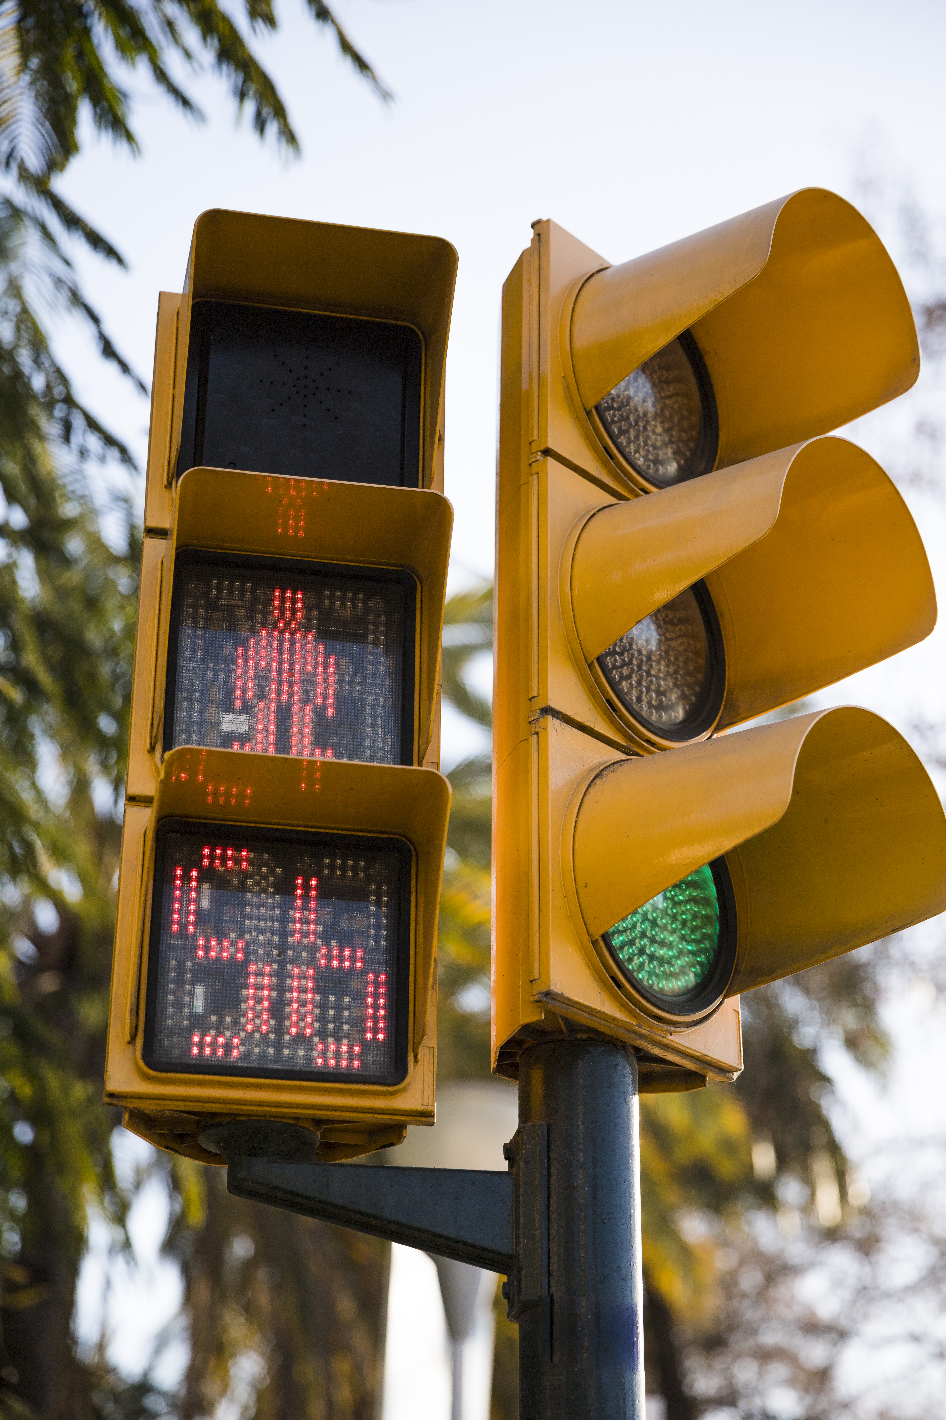



AI-Based Traffic Signal Optimization
Real-Time Detection
YOLOv8 accurately detects vehicles in real time, providing a dynamic understanding of traffic flow.
Predictive Timing
Lasso Regression predicts optimal signal timing based on detected vehicle counts, adapting to changing traffic conditions.
User-Friendly Interface
A Flask web application provides a user-friendly platform for visualization and system monitoring.

Slide 4
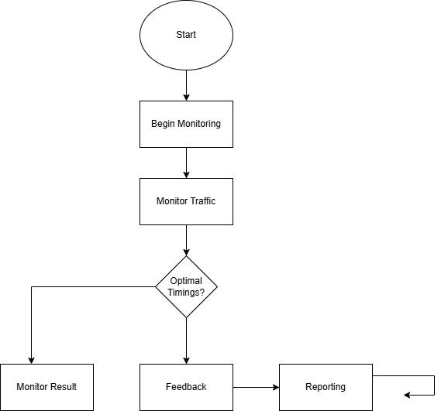
System Architecture
Components
YOLOv8: Real-time vehicle detection
Lasso Regression: Predictive timing
Flask: Backend web application
Data Flow
Video stream captured from traffic cameras
YOLOv8 detects and classifies vehicles
Lasso Regression predicts optimal signal timing based on detected vehicle counts
Predicted timing data is sent to the Flask app for visualization

Slide 5
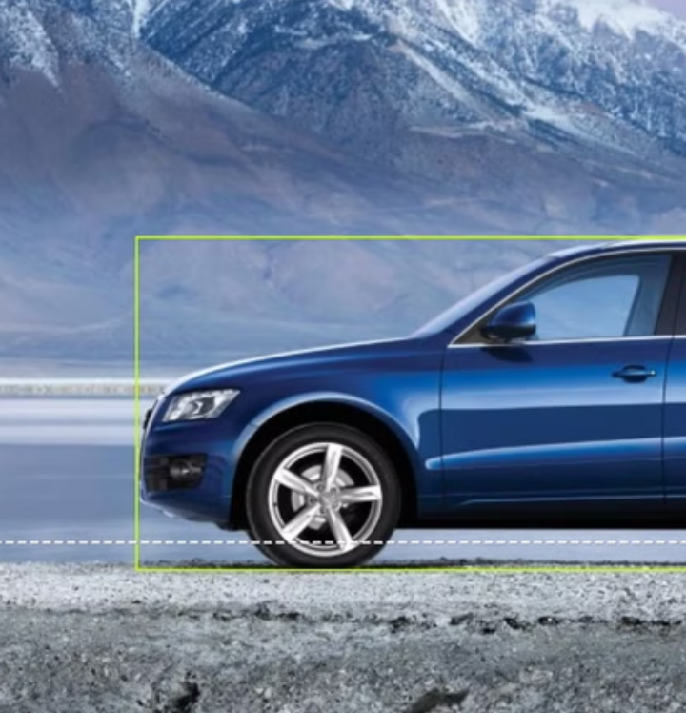
YOLOv8 - Real-Time Vehicle Detection
Custom Training
High Precision
YOLOv8 is trained with custom dataset to detect specific vehicles relevant to traffic flow.
The model achieves high detection accuracy with current dataset ensuring reliable results.
Real-Time Performance
YOLOv8's efficiency allows for real-time detection of cars, trucks, buses, and motorbikes, crucial for adaptive traffic management.

Slide 6
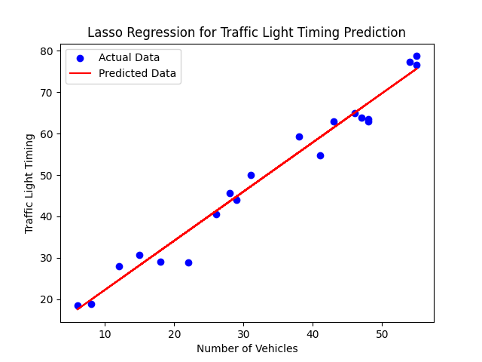
Lasso Regression - Predictive Timing
Input
Output
Number of detected vehicles
Optimized traffic light duration
Lasso Regression is trained on historical traffic datasets, learning the relationship between vehicle counts and optimal signal timing.

Slide 7


Flask Application
Upload Video Frames
Real-Time Visualization
Users can upload video frames for analysis, providing real-time data to the system.
The Flask app displays detected vehicles and predicted signal timing in a user-friendly interface.

Slide 8




Innovations and Advantages
Scalability
The system utilizes scalable technologies like YOLO and Flask, allowing for expansion to manage larger networks of traffic signals.
Real-Time Adaptability
Lasso Regression enables continuous learning and adaptation to changing traffic patterns, ensuring optimal performance.
Simple Deployment
The solution can be easily deployed in urban areas, integrated with existing infrastructure, and managed remotely.

Slide 9
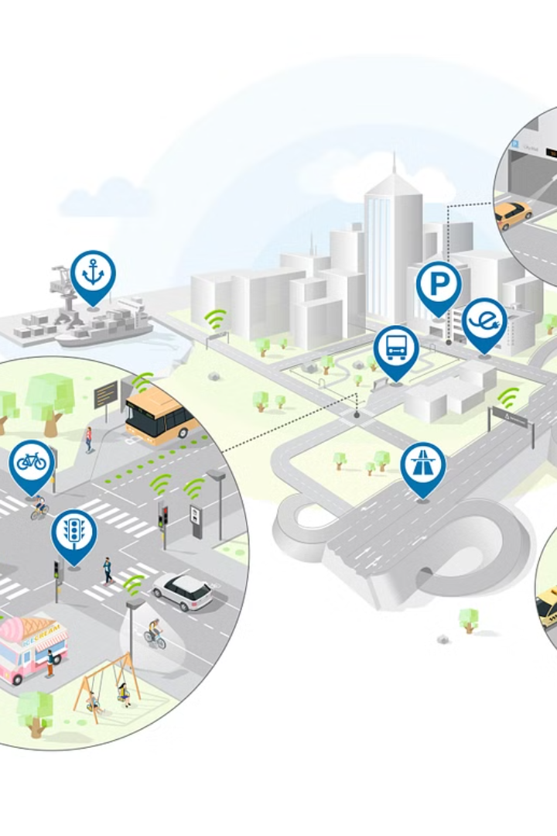
Future Scope
1
Vehicle Prioritization
2
IoT Integration
The system can be extended to prioritize specific vehicle types, such as emergency vehicles, for enhanced safety.
Integrating IoT sensors can provide real-time traffic data, enabling automated signal updates for dynamic traffic management.
3
City-Wide Implementation
The solution can be scaled for city-wide implementation, significantly improving traffic flow and reducing congestion.

Slide 10
Thank You..!!

